Slide 1
CMPE 110: Computer Architecture
Week 2
ISA II
Jishen Zhao (http://users.soe.ucsc.edu/~jzhao/)
[Adapted in part from Jose Renau, Mary Jane Irwin, Joe Devietti, Onur Mutlu, and others]

Slide 2
Reminder
Homework 1 will be posted on course Google site by today 4pm
Performance and ISA
Due by midnight Jan. 24

Slide 3
Review: ISA Overview
What is an ISA?
An ISA includes a specification of the set of opcodes and the native commands implemented by a particular processor. <Wikipedia>
Program execution model
High-level programming language (C/C++/Java/C#/…)
Assembly language
Human-readable representation
Machine language
1s and 0s (often displayed in “hex”)
Instruction execution model
App
App
App
System software
Mem
CPU
I/O
Fetch
Decode
Read Inputs
Execute
Write Output
Next Insn

Slide 4
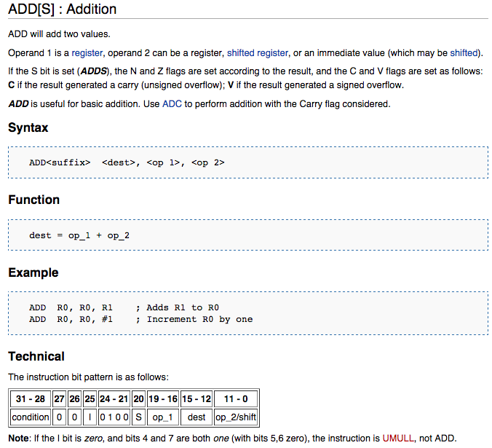
Review: An ADD Documentation
Notes:
Too small, read out

Slide 5
Review: ISA vs. Performance
Latency = seconds / program =
(insns / program) * (cycles / insn) * (seconds / cycle)
Insns / program: insn count
Impacted by program, compiler, ISA
Cycles / insn: CPI
Impacted by program, compiler, ISA, micro-arch
Seconds / cycle: clock period (Hz)
Impacted by micro-arch, technology
How does ISA affect insn count and CPI?
Example: CISC vs. RISC

Slide 6
CISC vs. RISC
CISC (Complex Instruction Set Computing) ISAs
Examples: Intel/AMD x86, IBM System/360, Intel 8051
Big heavyweight instructions (lots of work per instruction)
Low “insns/program”
Higher “cycles/insn” and “seconds/cycle”
RISC (Reduced Instruction Set Computer) ISAs
Examples: MIPS, ARM, Alpha
Simple instructions only: minimalist approach to an ISA
+ Low “cycles/insn” and “seconds/cycle”
Higher “insn/program”, but hopefully not as much

Slide 7
Today: ISA / Pipelining
ISA design goals
Programmability
Performance/implementability
Compatibility
Aspects of ISAs
Pipelining
Notes:
Overview of today’s class:
Metrics, how measure CPU performance,

Slide 8
ISA Design Goals

Slide 9
What Makes a Good ISA?
Programmability
Easy to express programs efficiently?
Performance/Implementability
Easy to design high-performance implementations?
Easy to design low-power implementations?
Easy to design low-cost implementations?
Compatibility
Easy to maintain as languages, programs, and technology evolve?
x86 (IA32) generations: 8086, 286, 386, 486, Pentium, PentiumII, PentiumIII, Pentium4, Core2, Core i7, …

Slide 10
Compatibility
In many domains, ISA must remain compatible
IBM’s 360/370 (the first “ISA family”)
Another example: Intel’s x86 and Microsoft Windows
x86 one of the worst designed ISAs EVER, but it survives
Backward compatibility
New processors supporting old programs
Hard to drop features
Update software/OS to emulate dropped features (slow)
Forward (upward) compatibility
Old processors supporting new programs
Include a “CPU ID” so the software can test for features
Add ISA hints by overloading no-ops (example: x86’s PAUSE)
New firmware/software on old processors to emulate new insn

Slide 11
Translation and Virtual ISAs
New compatibility interface: ISA + translation software
Binary-translation (static): transform static image, run native
Emulation (dynamic binary-translation): unmodified image, interpret each dynamic insn
Typically optimized with just-in-time (JIT) compilation
Examples: DEC FX!32 (x86 on Alpha), Rosetta (PowerPC on x86)
Performance overheads reasonable (many advances over the years)
Virtual ISAs: designed for translation, not direct execution
Target for high-level compiler (one per language)
Source for low-level translator (one per ISA)
Goals: Portability (abstract hardware nastiness), flexibility over time
Examples: Java Bytecodes, C# CLR (Common Language Runtime), NVIDIA’s “PTX”
Notes:
diff wrt virtualization software like VMWare, Virtual PC, Parallels, Xen, etc.
Rosetta is a dynamic binary translator for Mac OS X that allows many PowerPC applications to run on certain Intel-based Macintosh computers without modification. Apple released Rosetta in 2006 when it changed the instruction set architecture of the Macintosh platform from the PowerPC to the Intel processor.
Virtual ISA: An instruction set that can be compiled to, but requires additional transformations before it can be executed by hardware. The idea is that you can do most of the compiler optimizations on the virtual ISA and then target many different processors by doing simple instruction to instruction translations.

Slide 12
Ultimate Compatibility Trick
Support old ISA by…
…having a simple processor for that ISA somewhere in the system
How did PlayStation2 support PlayStation1 games?
Used PlayStation processor for I/O chip & emulation

Slide 13
What we learned
What is ISA?
Execution model:
Compilation
Assembly & machine language
Instruction execution model
Registers, memory, PC
Instruction execution
ISA design goals
Programmability
Performance/implementability
Compatibility
App
App
App
System software
Mem
CPU
I/O
Fetch
Decode
Read Inputs
Execute
Write Output
Next Insn

Slide 14
Aspects of ISAs

Slide 15
Aspects of ISAs
Instruction length and format
Instruction encoding
Where does data live?
Addressing modes
Control transfers
How to find the next instruction
Branch
Jump
Fetch
Decode
Read Inputs
Execute
Write Output
Next Insn

Slide 16
Length and Format
Length
Fixed length
Most common is 32 bits
Simple implementation (next PC often just PC+4)
Code density: 32 bits to increment a register by 1
Variable length
Code density
x86 averages 3 bytes (ranges from 1 to 16)
Complex fetch (where does next instruction begin?)
Compromise: two lengths
E.g., MIPS16 or ARM’s Thumb (16 bits)
Encoding
A few simple encodings simplify decoder
Machine code (1s and 0s) <-> assembly
Fetch[PC]
Decode
Read Inputs
Execute
Write Output
Next PC
Notes:
Machine code mapped to assemply

Slide 17
Example Instruction Encodings
MIPS
Fixed length
32-bits, 3 formats, simple encoding
x86
Variable length encoding (1 to 15 bytes)
^{add R1,R2,R3}
R-type
Op(6)
Rs(5)
Rt(5)
Rd(5)
Sh(5)
Func(6)
I-type
Op(6)
Rs(5)
Rt(5)
Immed(16)
J-type
Op(6)
Target(26)
Prefix*(1-4)
Op
OpExt*
ModRM*
SIB*
Disp*(1-4)
Imm*(1-4)

Slide 18
Where Does Data Live?
Fetch
Decode
Read Inputs
Execute
Write Output
Next Insn

Slide 19
Where Does Data Live?
Registers (e.g., R0, R1, F0)
“short term memory”
Faster than memory, quite handy
Named directly in instructions
F = Floating point registers (Special registers)
Memory (e.g., (R3), #20(R5) )
“longer term memory”
Accessed via “addressing modes”
Address to read or write calculated by instruction
“Immediates” (e.g., #36, #7)
Values spelled out as bits in instructions
Input only
^{ADD R1,R2,R3}
Fetch
Decode
Read Inputs
Execute
Write Output
Next Insn
^{ADD R1,R2,(R3)}

Slide 20
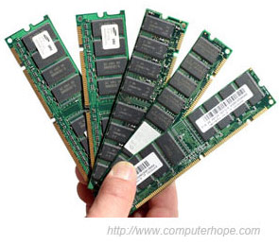
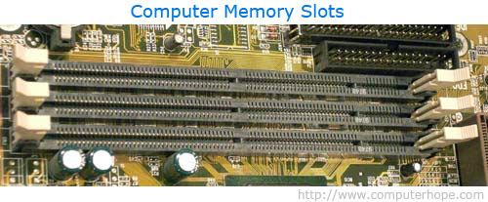
Memory Addressing
Data
Addresses
…
0x0004
0x0003
0101 0110
0x0002
1001 0101
0x0001
0001 0111
Notes:
displ:object, idx-base:array, mem-ind:**, scaled:array-of-structs, pc-rel:constant in insn memory

Slide 21
Memory Addressing
Addressing mode: way of specifying address
Examples
Displacement: address = [R2+immed], e.g., #20(R2)
Index-base: address = [R2+R3]
Memory-indirect: address =[mem[R2]]
Auto-increment: address=[R2], R2= R2+1
Auto-indexing: address =[R2+immed], R2=R2+immed
Scaled: address =[R2+R3*immed1+immed2]
PC-relative: address =[PC+imm]
Notes:
displ:object, idx-base:array, mem-ind:**, scaled:array-of-structs, pc-rel:constant in insn memory

Slide 22
Control Transfers
Default next-PC = PC + sizeof(current insn)
Branches and jumps can change that
Computing targets: where to jump to
For all branches and jumps
PC-relative: e.g., J offset for branches and jumps with function
Absolute: e.g., J L3 for function calls
Register indirect: e.g., JR R5 for returns, switches & dynamic calls
Testing conditions: whether to jump or not
Use registers & separate branch insns (MIPS)
e.g., bnez R2,target
Fetch
Decode
Read Inputs
Execute
Write Output
Next Insn
J L3
-4

Slide 23
Summary: ISA
What is ISA?
Execution model:
Compilation
Assembly & machine language
Instruction execution model
Registers, memory, PC
Instruction execution
ISA design goals
Programmability
Performance/implementability
Compatibility
Aspects of ISAs
App
App
App
System software
Mem
CPU
I/O
Fetch
Decode
Read Inputs
Execute
Write Output
Next Insn

